Slide 1
Computer Networking
Socket Programming

Slide 2
Client-Server Model
Typical network app has two pieces: client and server
Client:
An application that initiates the communication is called a client.
E.g., Web browser, FTP client, Telnet client, Email client
The client contacts a server, sends a request, and awaits a response
Server :
An application that waits for incoming communication requests from clients is called a server
E.g., Web server, FTP server, Telnet server, SMTP server
The server receives a client’s request, performs the necessary computation, and returns the result to the client
Remark: Server is designed to provide service to multiple clients

Slide 3





Client-Server Model
Typical network app has two pieces: client and server
application
transport
network
data link
physical
request
reply
application
transport
network
data link
physical

Slide 4
Server and Client
Server and Client exchange messages over the network through a common Socket API
Server
Clients
user
space
ports
TCP/UDP
TCP/UDP
Socket API
kernel
space
IP
IP
Ethernet Adapter
Ethernet Adapter
hardware

Slide 5

Ftp: The File Transfer Protocol
FTP
user
interface
FTP
client
file transfer
FTP
server
user
at host
local file
system
remote file
system
Transfer file to/from remote host
Client/server model
  Client: side that initiates transfer (either to/from remote)
  Server: remote host
ftp: RFC 959
ftp server: port 21

Slide 6
Ftp: Separate Control, Data Connections
Ftp client contacts ftp server at port 21, specifying TCP as transport protocol
Two parallel TCP connections opened:
  Control: exchange commands, responses between client, server.
    “out of band control”
  Data: file data to/from server
TCP control connection
port 21
FTP
client
TCP data connection
port 20
FTP
server

Slide 7
How to Write Network Applications?
TCP/IP is implemented inside the OS
OS exports the TCP/IP functionalities through SOCKET APIs (Application Program Interface, ) A set of functions
Develop N/W applications using SOCKET APIs
To learn SOCKET programming
  Learn some data structures
  Learn the socket APIs
  Learn multi-threading

Slide 8
Types of Sockets
Under protocol family AF_INET
  Stream socket : Uses TCP for connection-oriented reliable communication
  Identified by SOCK_STREAM
  s = socket(AF_INET, SOCK_STREAM, 0) ;
  Datagram socket : Uses UDP for connectionless communication
  Identified by SOCK_DGRAM
  s = socket(AF_INET, SOCK_DGRAM, 0) ;
  RAW socket : Uses IP directly
    Identified by SOCK_RAW

Slide 9
What is a Socket?
A socket is a file descriptor that lets an application read/write data from/to the network
socket returns an integer (socket descriptor)
  fd < 0 indicates that an error occurred
  socket descriptors are similar to file descriptors
AF_INET: associates a socket with the Internet protocol family
SOCK_STREAM: selects the TCP protocol
SOCK_DGRAM: selects the UDP protocol
int fd; /* socket descriptor */
if ((fd = socket(AF_INET, SOCK_STREAM, 0)) < 0) }
perror(“socket”);
exit(1);
}

Slide 10
User Datagram Protocol(UDP):
An Analogy
UDP
Single socket to receive messages
No guarantee of delivery
Not necessarily in-order delivery
Datagram – independent packets
Must address each packet
Postal Mail
Single mailbox to receive messages
Unreliable ☺
Not necessarily in-order delivery
Each letter is independent
Must address each reply
Postal Mail
Single mailbox to receive letters
Unreliable ☺
Not necessarily in-order delivery
Letters sent independently
Must address each reply
Example UDP applications
Multimedia, voice over IP

Slide 11
Transmission Control Protocol (TCP): An Analogy
TCP
Reliable – guarantee delivery
Byte stream – in-order delivery
Connection-oriented – single socket per connection
Setup connection followed by data transfer
Telephone Call
Guaranteed delivery
In-order delivery
Connection-oriented
Setup connection followed by conversation
Example TCP applications
  Web, Email, Telnet

Slide 12
Network Addressing Analogy
Telephone Call
Network Programming
Professors at CMU
Applications/Servers
412-268-8000 ext.123
412-268-8000 ext.654
Web
Port 80
Mail
Port 25
Extension
Port No.
Telephone No
IP Address
Central Number
Network No.
Exchange
Host Number
Area Code
15-441 Students
Clients

Slide 13
Concept of Port Numbers
  Port numbers are used to identify “entities” on a host
  Port numbers can be
    Well-known (port 0-1023)
    Dynamic or private (port 1024-65535)
  Servers/daemons usually use well-known ports
    Any client can identify the server/service
    HTTP = 80, FTP = 21, Telnet = 23, .
    /etc/service defines well-known ports
  Clients usually use dynamic ports
    Assigned by the kernel at run time
NTP
daemon
Web
server
port 123
port 80
TCP/UDP
IP
Ethernet Adapter

Slide 14
Byte Ordering
  Memory is organized in bytes.
  16-bit integer takes 2 bytes; a 32-bit integer takes 4 bytes.
  Different machines use different host bye orderings:
  little-endian: least significant byte located at lower memory E.g., Intel 80x86
  big-endian: least significant byte located at higher memory E.g., Motorola 68000
  These machines may communicate with one another over the n/w , and they may have different understandings on the same data.
  Not a problem for data type char

Slide 15
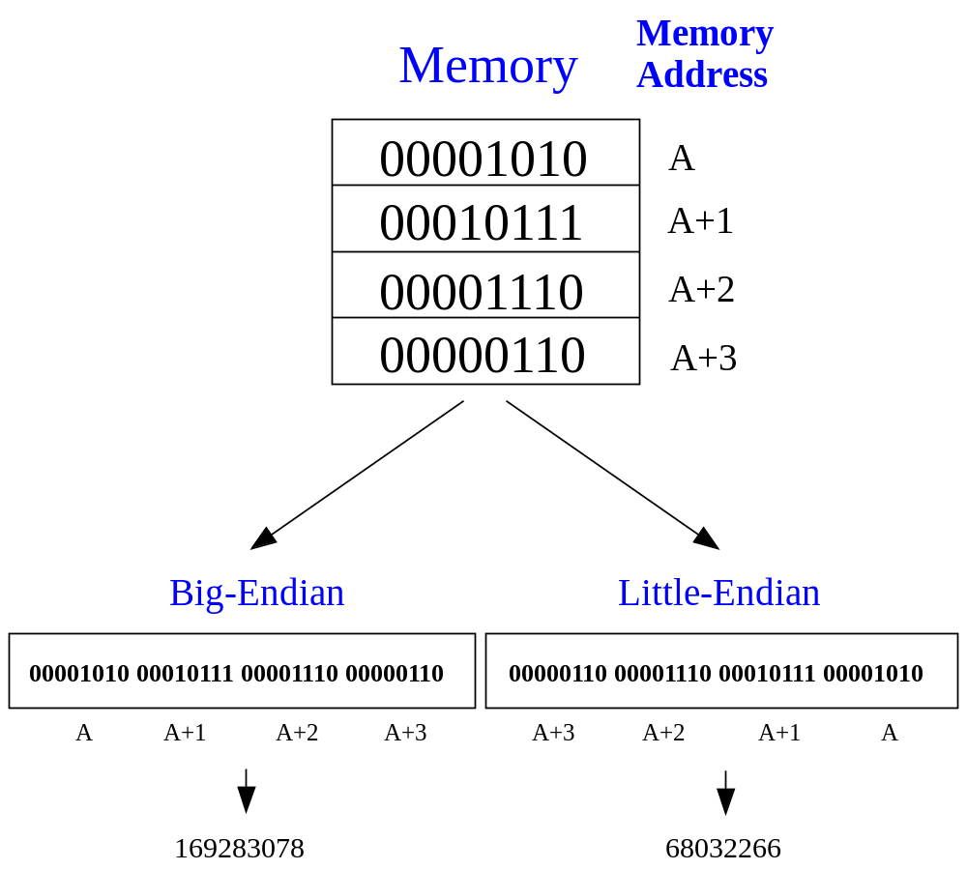
Chaos of Byte Order
Big-Endian Computer
Send out an integer
169283078
Little-Endian Computer
Receive an integer
68032266!

Slide 16
Solution: Network Byte Order
Let’s have some regulation!
  Network byte order is defined as big-endian byte order
  Integers should be sent out in network byte order
The members sin_port and sin_addr in struct sockaddr_in should be in network byte order
  sin_port: TCP or UDP port number, put into the TCP/UDP header
  sin_addr: IP address, put into the IP header

Slide 17
Solution: Network Byte Order
The member sin_family will not be sent out to the network. So it is not necessary to be in network byte order.
If your application needs to transfer integers between two machines, you should transfer them into network byte order.
  You don’t know the type of CPU that executes your program!

Slide 18
Network Byte Order
When sending out an integer
  Transfer it into network byte order by:
  u_short htons (u_short host_short);
  u_long htonl (u_long host_long);
After receiving an integer
  Transfer it into (local) host byte order by:
  u_short ntohs (u_short network_short);
  u_long ntohl (u_long network_long);
  u_short: unsigned 16-bit integer
  u_long: unsigned 32-bit integer
h: host
n: network
s: short
l: long
h-to-n-s
h-to-n-l
n-to-h-s
n-to-h-l

Slide 19
Byte Ordering
union {
u_int32_t addr; /* 4 bytes address */
char c[4];
} un;
/* 128.2.194.95 */
un.addr = 0x8002c25f;
/* c[0] = ? */
c[0] c[1] c[2] c[3]
128
2
194
95
Big Endian
  Sun Solaris, PowerPC, ...
Little Endian
  i386, alpha, ...
Network byte order = Big Endian
95
194
2
128

Slide 20
Byte Ordering Functions
Converts between host byte order and network byte order
  ‘h’ = host byte order
  ‘n’ = network byte order
  ‘l’ = long (4 bytes), converts IP addresses
  ‘s’ = short (2 bytes), converts port numbers
#include <netinet/in.h>
unsigned long int htonl(unsigned long int hostlong);
unsigned short int htons(unsigned short int hostshort);
unsigned long int ntohl(unsigned long int netlong);
unsigned short int ntohs(unsigned short int netshort);

Slide 21
Socket Descriptors
To perform file I/O, we use a file descriptor.
Similarly, to perform N/W I/O, we use a socket descriptor:
  Each active socket is identified by its socket descriptor.
  The data type of a socket descriptor is SOCKET.
  Hack into the header file winsock2.h:
    typedef u_int SOCKET; /* u_int is defined as unsigned int */
  In UNIX systems, socket is just a special file, and socket descriptors are kept in the file descriptor table.

Slide 22
System Data Structures for Sockets
When an application process calls socket(), the OS allocates a new data structure to hold the information needed for communication, and fills in a new entry in the process’s socket descriptor table (SDT) with a pointer to the data structure.
  A process may use multiple sockets at the same time. The socket descriptor table is used to manage the sockets for this process.
  Different processes use different SDTs.

Slide 23
System Data Structures for Sockets
The internal data structure for a socket contains many fields, but the system leaves most of them unfilled. The application must make additional procedure calls to fill in the socket data structure before the socket can be used.
The socket is used for data communication between two processes ( may locate at different machines).
So the socket data structure should at least contain the address information, e.g., IP addresses, port numbers, etc.

Slide 24
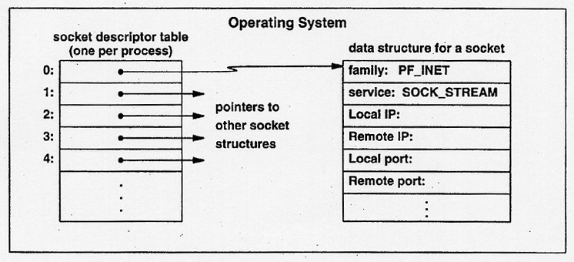
System Data Structures for Sockets
Conceptual operating system (Windows) data structures after five calls to socket() by a process.
The system keeps a separate socket descriptor table for each process; threads in the process share the table.

Slide 25
Internet Addressing Data Structure
#include <netinet/in.h>
/* Internet address structure */
struct in_addr {
u_long s_addr; /* 32-bit IPv4 address */
}; /* network byte ordered */
/* Socket address, Internet style. */
struct sockaddr_in {
u_char sin_family; /* Address Family */
u_short sin_port; /* UDP or TCP Port# */
/* network byte ordered */
struct in_addr sin_addr; /* Internet Address */
char sin_zero[8]; /* unused */
};
sin_family = AF_INET selects Internet address family

Slide 26
Addressing Issue
How to identify a communication?
  Source IP Address, Source Port Number, Destination IP Address, Destination Port Number
  TCP or UDP
IPv4 address: 32-bit
Port number: 16-bit
Better to have a data structure that contains the addressing information
  To simplify the socket APIs
  Number of function parameters can be decreased

Slide 27
Specifying an Endpoint Address
When a socket is created, it doesn’t contain address information of either local machine or the remote machine.
Before an application uses a socket for sending/receiving data, it must specify one or both of these addresses for the socket.
  This can simplify the APIs.
TCP/IP define a communication endpoint to consist of an IP address and a protocol port number.
  when you create the socket, you already specified whether this socket is using TCP or UDP.

Slide 28
Generic Address Structure
  A general structure: struct sockaddr
  A specific structure for IPv4: struct sockaddr_in
The socket system defines a generic endpoint address:
  (address family, endpoint address in that family)
  The purpose is to provide a common interface for different kinds of protocol families
struct sockaddr {
u_short sa_family; /* address family */
char sa_data[14]; /* upto 14 bytes direct address */
};

Slide 29
Generic Address Structure
Unfortunately, not all address families define endpoints that fit into the sockaddr structure!
To keep program portable and maintainable, TCP/IP code should not use the sockaddr structure in declarations.
Instead, another structure sockaddr_in should be used to represent a socket address in AF_INET family.

Slide 30
TCP/IP Endpoint Address
TCP/IP (IPv4) endpoint address is defined as:
(AF_INET, 2-byte port number, 4-byte IP address, 8-byte zero).
struct sockaddr_in {
short sin_family; /* type of address, always AF_INET */
u_short sin_port; /* protocol port number */
struct in_addr sin_addr; /* IP address */
char sin_zero[8]; /* unused */
};
The IP address is stored in structure sin_addr with type struct in_addr:
struct in_addr {
union {
struct { u_char s_b1,s_b2,s_b3,s_b4; } S_un_b;
struct { u_short s_w1,s_w2; } S_un_w;
u_long S_addr;
} S_un;
#define s_addr S_un.S_addr
…
};
The 32-bit IP address can be explained as 4 unsigned bytes, or 2 unsigned short, or an unsigned long. By using a union, you can manipulate the IP address conveniently.

Slide 31
sockaddr vs. sockaddr_in
struct sockaddr
struct sockaddr_in
2 bytes
sa_family
sin_family
2 bytes
sin_port
2 bytes
sin_addr
4 bytes
14 bytes
sa_data
sin_zero
8 bytes
A pointer to a struct sockaddr_in can be cast to a pointer to a struct sockaddr and vice-versa.

Slide 32
Comparison Between TCP and UDP
Common function calls
  socket(), closesocket() , bind()
Differences
  TCP is connection-oriented, UDP is connectionless
    TCP applications use listen(), accept(), connect() to setup TCP connections
  Data transfer
    TCP applications use send() and recv()
    UDP applications use sendto() and recvfrom()

Slide 33
TCP Server
For example: web server
What does a web server need to do so that a web client can connect to it?
Web Server
Port 80
TCP
IP
Ethernet Adapter

Slide 34
Socket I/O: socket()
Since web traffic uses TCP, the web server must create a socket of type SOCK_STREAM
int fd; /* socket descriptor */
if((fd = socket(AF_INET, SOCK_STREAM, 0)) < 0) {
perror(“socket”);
exit(1);
}
socket returns an integer (socket descriptor)
  fd < 0 indicates that an error occurred
AF_INET associates a socket with the Internet protocol family
SOCK_STREAM selects the TCP protocol

Slide 35
Socket I/O: bind()
A socket can be bound to a port
int fd; /* socket descriptor */
struct sockaddr_in srv; /* used by bind() */
/* create the socket */
srv.sin_family = AF_INET; /*use Internet addr family */
srv.sin_port = htons(80); /* bind socket ‘fd’ to port 80*/
/* bind: a client may connect to any of my addresses */
srv.sin_addr.s_addr = htonl(INADDR_ANY);
if(bind(fd, (struct sockaddr*) &srv, sizeof(srv)) < 0) {
perror("bind"); exit(1);
}

Slide 36
Socket I/O: listen()
listen indicates that the server will accept a connection
int fd; /* socket descriptor */
struct sockaddr_in srv; /* used by bind() */
/* 1) create the socket */
/* 2) bind the socket to a port */
if(listen(fd, 5) < 0) {
perror(“listen”);
exit(1);
}

Slide 37
Socket I/O: accept()
accept blocks waiting for a connection
int fd; /* socket descriptor */
struct sockaddr_in srv; /* used by bind() */
struct sockaddr_in cli; /* used by accept() */
int newfd; /* returned by accept() */
int cli_len = sizeof(cli); /* used by accept() */
/* 1) create the socket */
/* 2) bind the socket to a port */
/* 3) listen on the socket */
newfd = accept(fd, (struct sockaddr*) &cli, &cli_len);
if(newfd < 0) {
perror("accept"); exit(1);
}
accept returns a new socket (newfd) with the same properties as the original socket (fd)
  newfd < 0 indicates that an error occurred

Slide 38
struct sockaddr_in cli; /* used by accept() */
int newfd; /* returned by accept() */
int cli_len = sizeof(cli); /* used by accept() */
newfd = accept(fd, (struct sockaddr*) &cli, &cli_len);
if(newfd < 0) {
perror("accept");
exit(1);
}
How does the server know which client it is?
  cli.sin_addr.s_addr contains the client’s IP address
  cli.sin_port contains the client’s port number
Now the server can exchange data with the client by using read and write on the descriptor newfd.
Why does accept need to return a new descriptor?

Slide 39
Socket I/O: read()
read can be used with a socket
read blocks waiting for data from the client but does not guarantee that sizeof(buf) is read
int fd; /* socket descriptor */
char buf[512]; /* used by read() */
int nbytes; /* used by read() */
/* 1) create the socket */
/* 2) bind the socket to a port */
/* 3) listen on the socket */
/* 4) accept the incoming connection */
if((nbytes = read(newfd, buf, sizeof(buf))) < 0) {
perror(“read”); exit(1);
}

Slide 40
TCP Client
For example: web client
How does a web client connect to a web server?
2 Web Clients
TCP
IP
Ethernet Adapter

Slide 41
Dealing with IP Addresses
IP Addresses are commonly written as strings (“128.2.35.50”), but programs deal with IP addresses as integers.
Converting strings to numerical address:
struct sockaddr_in srv;
srv.sin_addr.s_addr = inet_addr(“128.2.35.50”);
if(srv.sin_addr.s_addr == (in_addr_t) -1) {
fprintf(stderr, "inet_addr failed!\n"); exit(1);
}
Converting a numerical address to a string:
struct sockaddr_in srv;
char *t = inet_ntoa(srv.sin_addr);
if(t == 0) {
fprintf(stderr, “inet_ntoa failed!\n”); exit(1);
}

Slide 42
Socket I/O: connect()
connect allows a client to connect to a server...
int fd; /* socket descriptor */
struct sockaddr_in srv; /* used by connect() */
/* create the socket */
/* connect: use the Internet address family */
srv.sin_family = AF_INET;
/* connect: socket ‘fd’ to port 80 */
srv.sin_port = htons(80);
/* connect: connect to IP Address “128.2.35.50” */
srv.sin_addr.s_addr = inet_addr(“128.2.35.50”);
if(connect(fd, (struct sockaddr*) &srv, sizeof(srv)) < 0) {
perror(”connect"); exit(1);
}

Slide 43
Socket I/O: write()
write can be used with a socket
int fd; /* socket descriptor */
struct sockaddr_in srv; /* used by connect() */
char buf[512]; /* used by write() */
int nbytes; /* used by write() */
/* 1) create the socket */
/* 2) connect() to the server */
/* Example: A client could “write” a request to a server */
if((nbytes = write(fd, buf, sizeof(buf))) < 0) {
perror(“write”);
exit(1);
}

Slide 44
Review: TCP Client-Server Interaction
TCP Server
socket()
bind()
TCP Client
listen()
socket()
accept()
connection establishment
connect()
data request
read()
write()
data reply
write()
read()
close()
end-of-file notification
read()
close()

Slide 45
UDP Server Example
For example: NTP daemon
What does a UDP server need to do so that a UDP client can connect to it?
NTP
daemon
Port 123
UDP
IP
Ethernet Adapter

Slide 46
Socket I/O: socket()
The UDP server must create a datagram socket…
int fd; /* socket descriptor */
if((fd = socket(AF_INET, SOCK_DGRAM, 0)) < 0) {
perror(“socket”);
exit(1);
}
socket returns an integer (socket descriptor)
  fd < 0 indicates that an error occurred
AF_INET: associates a socket with the Internet protocol family
SOCK_DGRAM: selects the UDP protocol

Slide 47
Socket I/O: bind()
A socket can be bound to a port
Now the UDP server is ready to accept packets…
int fd; /* socket descriptor */
struct sockaddr_in srv; /* used by bind() */
/* create the socket */
/* bind: use the Internet address family */
srv.sin_family = AF_INET;
/* bind: socket ‘fd’ to port 80*/
srv.sin_port = htons(80);
/* bind: a client may connect to any of my addresses */
srv.sin_addr.s_addr = htonl(INADDR_ANY);
if(bind(fd, (struct sockaddr*) &srv, sizeof(srv)) < 0) {
perror("bind"); exit(1);}

Slide 48
Socket I/O: recvfrom()
read does not provide the client’s address to the UDP server
int fd; /* socket descriptor */
struct sockaddr_in srv; /* used by bind() */
struct sockaddr_in cli; /* used by recvfrom() */
char buf[512]; /* used by recvfrom() */
int cli_len = sizeof(cli); /* used by recvfrom() */
int nbytes; /* used by recvfrom() */
/* 1) create the socket */
/* 2) bind to the socket */
nbytes = recvfrom(fd, buf, sizeof(buf), 0 /* flags */,
(struct sockaddr*) &cli, &cli_len);
if(nbytes < 0) {
perror(“recvfrom”); exit(1);
}

Slide 49
Socket I/O: recvfrom() continued...
nbytes = recvfrom(fd, buf, sizeof(buf), 0
/* flags */,
(struct sockaddr*) cli, &cli_len);
The actions performed by recvfrom
  returns the number of bytes read (nbytes)
  copies nbytes of data into buf
  returns the address of the client (cli)
  returns the length of cli (cli_len)
  don’t worry about flags

Slide 50
UDP Client Example
How does a UDP client communicate with a UDP server?
2 UDP Clients
ports
TCP
IP
Ethernet Adapter

Slide 51
Socket I/O: sendto()
write is not allowed
Notice that the UDP client does not bind a port number
  a port number is dynamically assigned when the first sendto is called
int fd; /* socket descriptor */
struct sockaddr_in srv; /* used by sendto() */
/* 1) create the socket */
/* sendto: send data to IP “128.2.35.50” port 80 */
srv.sin_family = AF_INET;
srv.sin_port = htons(80);
srv.sin_addr.s_addr = inet_addr(“128.2.35.50”);
nbytes = sendto(fd, buf, sizeof(buf), 0 /* flags */,
(struct sockaddr*) &srv, sizeof(srv));
if(nbytes < 0) {
perror(“sendto”); exit(1);
}

Slide 52
Review: UDP Client-Server
Interaction
UDP Server
socket()
bind()
UDP Client
recvfrom()
socket()
blocks until datagram
received from a client
sendto()
data request
data reply
sendto()
recvfrom()
close()

Slide 53
The UDP Server
UDP Server
How can the UDP server service multiple ports simultaneously?
Port 3000
Port 2000
UDP
IP
Ethernet Adapter

Slide 54
UDP Server: Servicing Two Ports
int s1; /* socket descriptor 1 */
int s2; /* socket descriptor 2 */
/* 1) create socket s1 */
/* 2) create socket s2 */
/* 3) bind s1 to port 2000 */
/* 4) bind s2 to port 3000 */
while(1) {
recvfrom(s1, buf, sizeof(buf), ...);
/* process buf */
recvfrom(s2, buf, sizeof(buf), ...);
/* process buf */
}
What problems does this code have?

Slide 55
Socket I/O: select()
int select(int maxfds, fd_set *readfds, fd_set *writefds,
fd_set *exceptfds, struct timeval *timeout);
FD_CLR(int fd, fd_set *fds); /* clear the bit for fd in fds */
FD_ISSET(int fd, fd_set *fds); /* is the bit for fd in fds? */
FD_SET(int fd, fd_set *fds); /* turn on the bit for fd in fds */
FD_ZERO(fd_set *fds); /* clear all bits in fds */

Slide 56
Socket I/O: select()
maxfds: number of descriptors to be tested
  descriptors (0, 1, ... maxfds-1) will be tested
readfds: a set of fds we want to check if data is available
  returns a set of fds ready to read
  if input argument is NULL, not interested in that condition
writefds: returns a set of fds ready to write
exceptfds: returns a set of fds with exception conditions

Slide 57
Socket I/O: select()
int select(int maxfds, fd_set *readfds, fd_set *writefds, fd_set *exceptfds, struct timeval *timeout);
struct timeval {
long tv_sec; /* seconds /
long tv_usec; /* microseconds */
}
timeout
  if NULL, wait forever and return only when one of the descriptors is ready for I/O
  otherwise, wait up to a fixed amount of time specified by timeout
    if we don’t want to wait at all, create a timeout structure with timer value equal to 0

Slide 58
Socket I/O: select()
select allows synchronous I/O multiplexing
int s1, s2; /* socket descriptors */
fd_set readfds; /* used by select() */
/* create and bind s1 and s2 */
while(1) {
FD_ZERO(&readfds); /* initialize the fd set */
FD_SET(s1, &readfds); /* add s1 to the fd set */
FD_SET(s2, &readfds); /* add s2 to the fd set */
if(select(s2+1, &readfds, 0, 0, 0) < 0) {
perror(“select”);
exit(1); }
if(FD_ISSET(s1, &readfds)) {
recvfrom(s1, buf, sizeof(buf), ...);
/* process buf */
}
/* do the same for s2 */ }

Slide 59
More Details About a Web Server
How can a a web server manage
multiple connections simultaneously?
Web Server
Port 8001
Port 80
TCP
IP
Ethernet Adapter

Slide 60
Socket I/O: select()
int fd, next=0; /* original socket */
int newfd[10]; /* new socket descriptors */
while(1) {
fd_set readfds;
FD_ZERO(&readfds); FD_SET(fd, &readfds);
/* Now use FD_SET to initialize other newfd’s
that have already been returned by accept() */
select(maxfd+1, &readfds, 0, 0, 0);
if(FD_ISSET(fd, &readfds)) {
newfd[next++] = accept(fd, ...);
}
/* do the following for each descriptor newfd[n] */
if(FD_ISSET(newfd[n], &readfds)) {
read(newfd[n], buf, sizeof(buf));
/* process data */
} }
Now the web server can support multiple connections...

